Slide 1
GLOBAL TRANSPORTATION & LOGISTICS
GLOBAL TRANSPORTATION & LOGISTICS
ADG offers a single source to manage your global transportation and freight, giving you the capacity to extend your business reach. Our experienced staff can design effective solutions for your company using a vast network of transportation modes. Our service performance includes:

Slide 2
WAREHOUSING & INVENTORY MANAGEMENT
1. Do you have the right product in the right location in the right quantities?
2. Spending too much time looking for stuff you may or may not have?
3. Is your current provider not meeting expectations?
4. Do you need visibility of your inventory in the internet?
If you answered "NO" to all or some of these questions, you need ADG. ADG provides pallet or bulk storage according to your needs in a secure facility with motion-sensing alarms. Our JIT project managers track and report cycle and complete physical inventory counts and minimum/maximum inventory level monitoring using best-in-class technology.

Slide 3
TEMPORARY LABOR
TEMPORARY LABOR
ADG can assist any businesses of any size to get products and services to market faster with economical business process outsourcing. More importantly, we can identify redundancies and inefficiencies in your processes for optimal cost savings. By shortening your supply chain and minimizing your days of sales outstanding will also give you a competitive advantage in the marketplace. Let ADG find the perfect balance with effective and efficient personnel who are thoroughly screened, trained and professional. We provide personnel proficient in best practices of business process outsourcing.

Slide 4
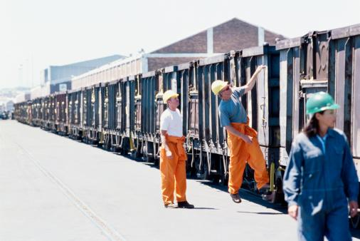
RAIL & INTERMODAL FREIGHT
RAIL & INTERMODAL FREIGHT
Save even more in transportation costs using the dependable, cost-effective rail option. ADG has partnerships with some of the largest companies in the US.

Slide 5
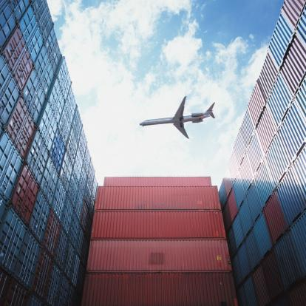
AIR CARGO
AIR CARGO
Let ADG handle any size and schedule of your air freight to any location. Our priority is to identify the best cost solution and adherence to trade compliance while ensuring product reaches the final destination intact and on-time. Atlanta is our home which is also the location of the largest international airport in the world for both passenger and cargo air transportation.

Slide 6
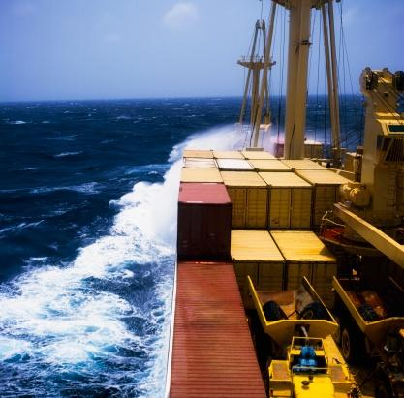
OCEAN FREIGHT
OCEAN FREIGHT
Our ocean freight experience and relationships allow our customers to depend on a regular transit schedule and sailings from major ports worldwide. ADG is located within a few hours of the third largest sea port in the United States, Savannah.

Slide 7
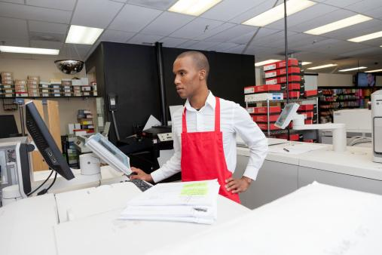
FULFILLMENT SERVICES
FULFILLMENT SERVICES
ADG provides complete pick-and-pack shipping: B2B, B2C, Ecommerce including bulk distribution, marketing material distribution, pre-ticketing (labeling), kit-building if you need to assemble a custom package for your clients.

Slide 8
SUPPLIER MANAGEMENT
SUPPLIER MANAGEMENT
We can furnish your company with the necessary components to energetically manage your overseas suppliers and logistics.

Slide 9
TRUCK FREIGHT
TRUCK FREIGHT
Depend on ADG to provide advantageous logistics management in the full range of cartage services.

